Slide 1
Slitless Stellar Spectroscopy with the SA100 Grating
Procedures used in the creation of the (ongoing) Harding Spectra Library

Slide 2
About the Presenter
Anthony Harding (Tony)
Lifelong astronomy enthusiast
Primarily a visual observer
Main area of interest is stellar evolution
Have been actively pursuing spectroscopy for approximately one year
Began creating Harding Spectra Library - Primarily as a means of gaining experience - Organized by constellation - Focused on constellation line stars
Library is available for free on rspec-astro.com website

Slide 3
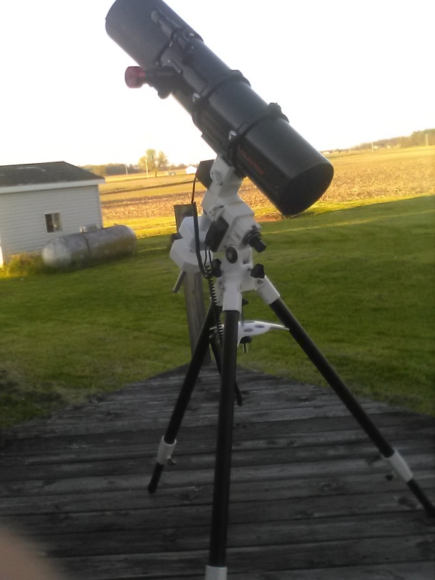
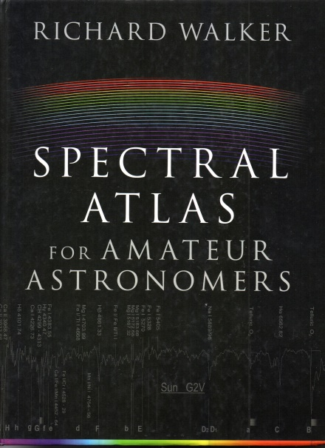
Equipment Used
Celestron C6-N Newtonian (f/5)
Meade LX85 Equatorial Got-To-Mount
SA100 Transmission Grating
ZWO ASI 290MM Monochrome Camera
ASI Studio Software
RSpec software
Richard Walker’s Spectral Atlas for Amateur Astronomers

Slide 4
Determine Instrument Response
Use A0V star, such as Vega, if available - Any late B-type to early A-type will work—the brighter the better
Fine-tune the focus on the spectrum, NOT the star!
Calibrate using zero order star image and Hβ line at 4861.3 Angstroms
Divide spectrum by reference profile for A0V star
Smooth out (remove) hydrogen Balmer lines and apply Spline Smoothing (gently!)
Save results—this is the Instrument Response Curve used for future captures of all stars
Make note of Angstroms/pixel
This procedure MUST be repeated if ANY part of the optical train changes!

Slide 5
Overview of Capture Procedure
Using ASICap Planetary Imaging module, capture footage of star in RAW16 (.SER file) format
Typical capture is 2-6 minutes
Gain at 0 if practical, otherwise no more than 200. - Keep Gain noise to a minimum.
Do NOT overexpose! - Underexpose if there is any question

Slide 6
Overview of Stacking Procedure
Use ASIVideoStack module
Use “Moon and Surface” option for stacking mode, with AoI centered on the star
Choose best-guess percentage (between 20% and 100%) of frames to apply to stacking - This may take several attempts

Slide 7
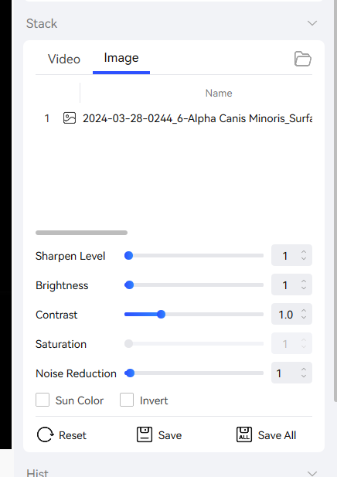
Overview of Stacking Procedure (continued)
After stack is complete, reduce Sharpen Level to minimum amount and Save

Slide 8
Prepare Image for RSpec
Open .FIT file in ASIFitsView module
Preview will appear HORRIBLE! -This is a preview issue with the software, not corrupted data!
Save as PNG or TIF file - You will want the image in a completely lossless format

Slide 9
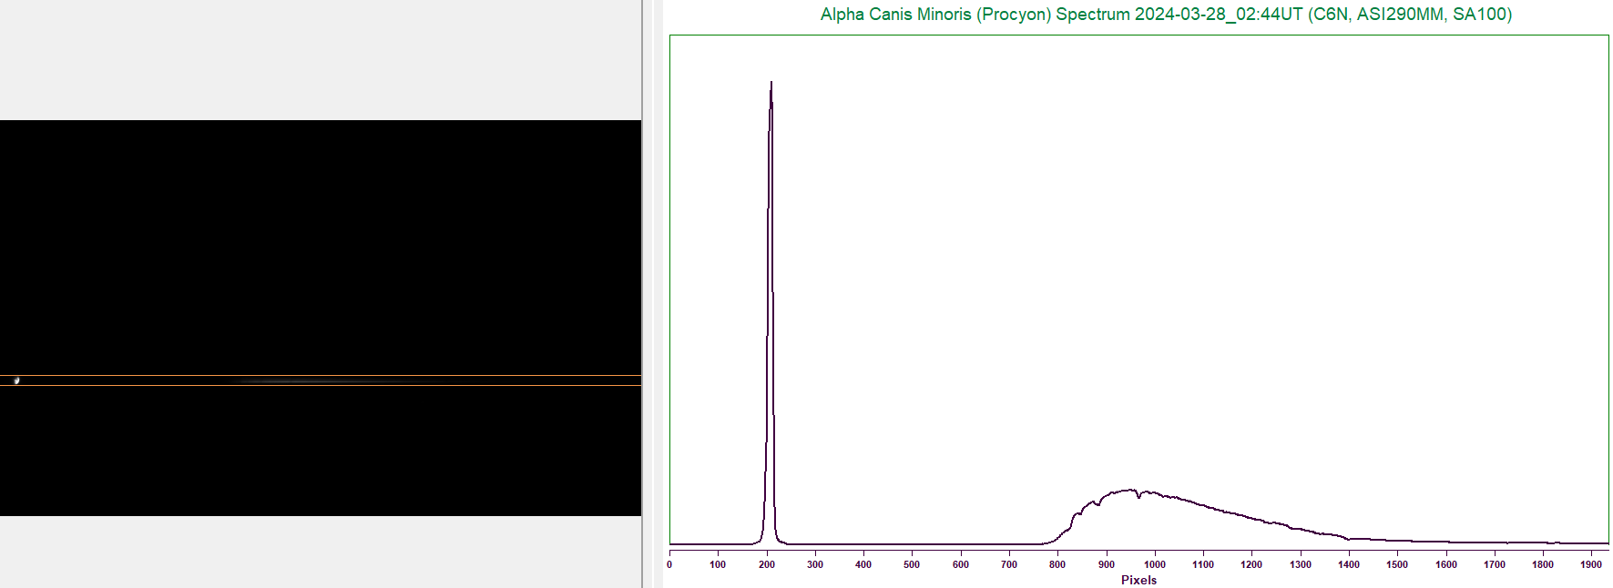
Processing of Spectrum
Open TIF or PNG file in Rspec
Bracket star and spectrum inside lines, rotating as needed
Sky background subtraction can be applied, but this can introduce additional noise

Slide 10
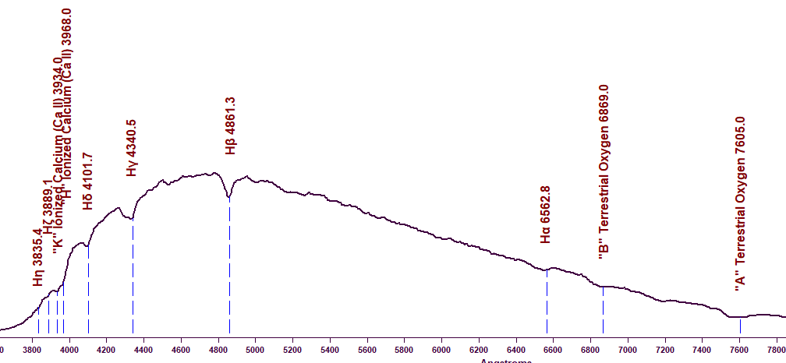
Processing of Spectrum (continued)
Perform one-point calibration using zero-order star image or other known prominent line, using the Angstroms/pixel estimate obtained during the creation of the Instrument Response Curve. The “Elements” feature can help determine if you are on-target. - Usable features include Hβ line at 4861.3 Angstroms (or other strong hydrogen Balmer lines), the magnesium triplet at 5170.0 Angstroms, calcium H and K lines at 3968/3934 Angstroms, etc. - Preferable to use line near the middle of the spectrum to minimize dispersion errors

Slide 11
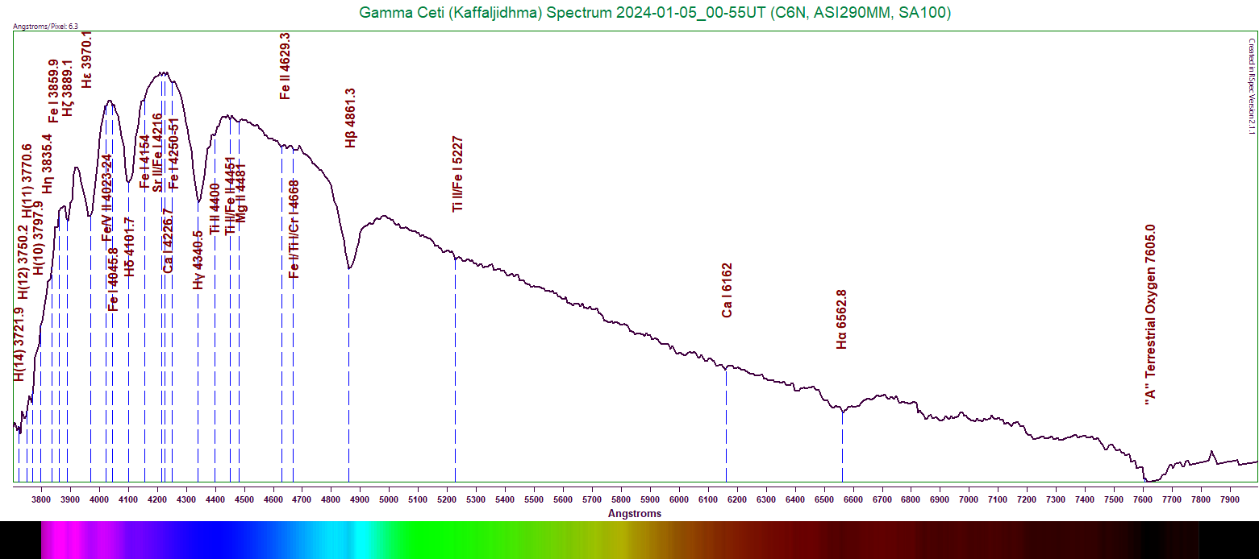
Processing of Spectrum (continued)
Trim the wavelength range to match that used when creating the Instrument Response Curve
Open Reference Series, using your Instrument Response Curve
Divide Main Profile (the data captured for the star) by the Reference Profile (your Instrument Response Curve). This is the instrument-corrected result.
Identify and label features and save result

Slide 12
Line Identification
This is the most time-consuming part of the process
Jagged and prominent dips in the continuum are obvious features
Use RSpec Elements feature and Walker’s Atlas to assist with identification (among others) - When using Walker’s Atlas, only moderate to strong features will usually show up in low-resolution spectra. The spectra presented in the Atlas are high-resolution, and are able to discern much more detail.
As a general rule, the deeper the feature appears, the stronger is its presence in the star. This is affected by temperature, pressure, etc.
Look for deviations from smooth, continuous curve
Rectified spectrum can be created as an aid, if desired - This does destroy some of the data, ie- wavelength peak
How to tell noise from subtle data? - Look at the continuum adjacent to the suspected feature

Slide 13
Example of Processing Stellar Spectrum
Alpha Canis Minoris (Procyon)
F5 Star
Expectations - Most hydrogen Balmer lines still fairly strong - A number of metals should be making themselves evident, even if only weakly

Slide 14
Alpha Canis Minoris Examining the Stacked Image
Details to note—
Slightly off horizontal
Star is not focused, but the spectrum is
If examined carefully, subtle gaps can already be seen in the spectrum - These gaps may not be visible if focus is bad - Gaps may appear to be missing for certain types of stars - Experience and practice will allow better recognition of these gaps

Slide 15
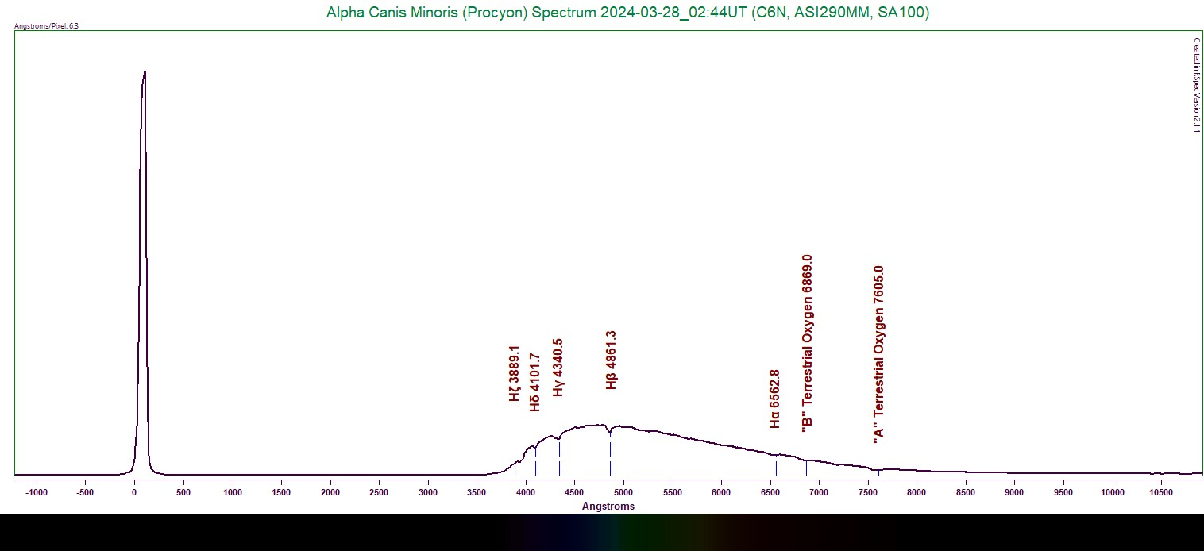
Alpha Canis Minoris Calibrating the Spectrum
Can use zero-order star image - Is very sensitive to dispersion errors
Better to use a known absorption line near the middle of the spectrum, if one is known - Minimizes dispersion errors on the “wings”

Slide 16
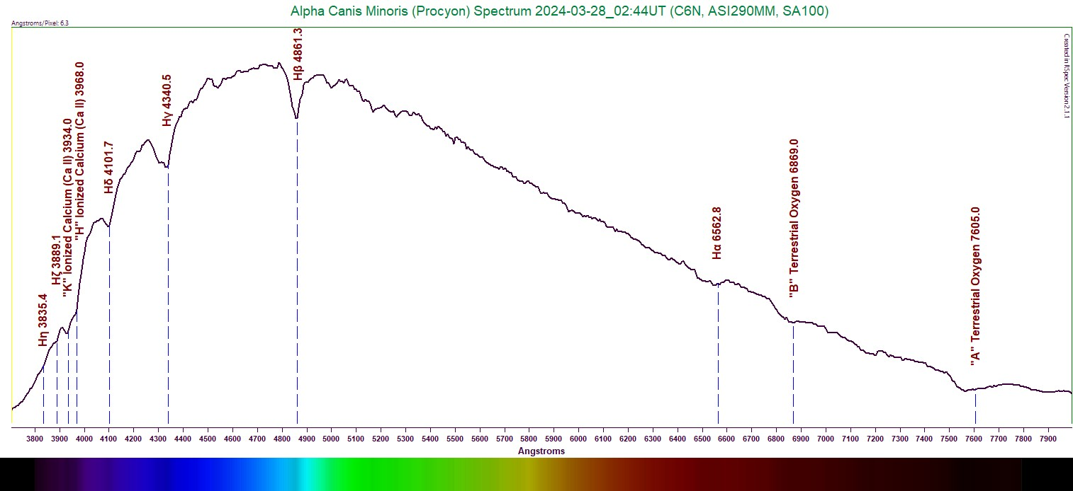
Alpha Canis Minoris Trimming the Spectrum
Trim the wavelength range to the same value used for your Instrument Response Curve

Slide 17
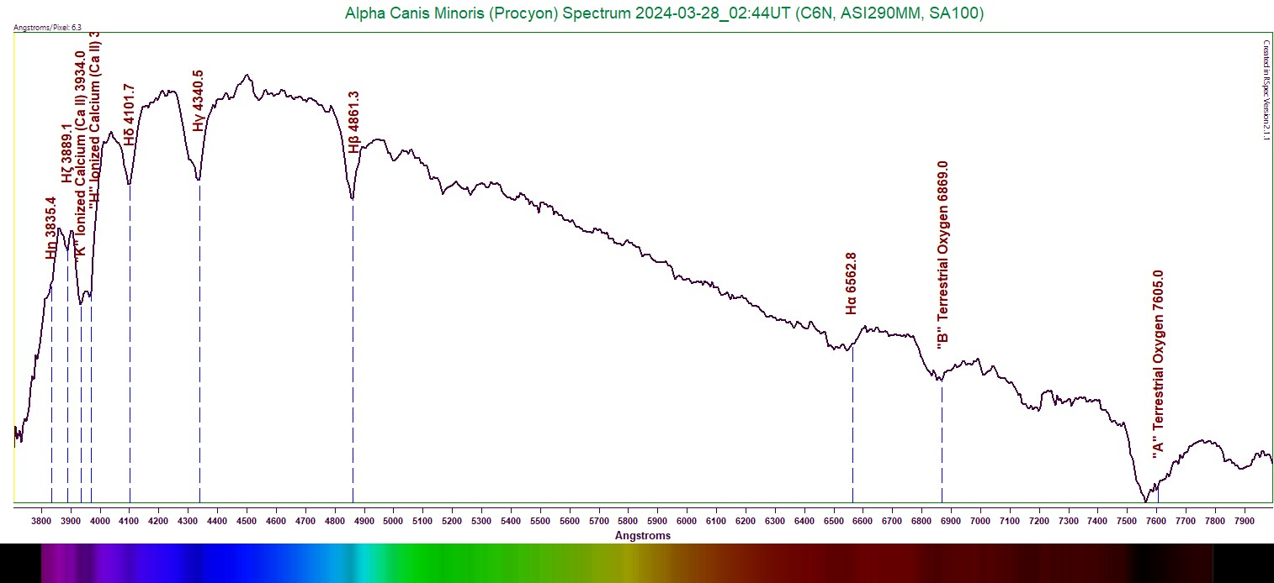
Alpha Canis Minoris Instrument Correcting the Spectrum
Load Reference Series and choose your Instrument Response Curve
Go to Math on 2 Series and divide your current spectrum by the Reference Series
The result will apply corrections for your camera, grating, and scope

Slide 18
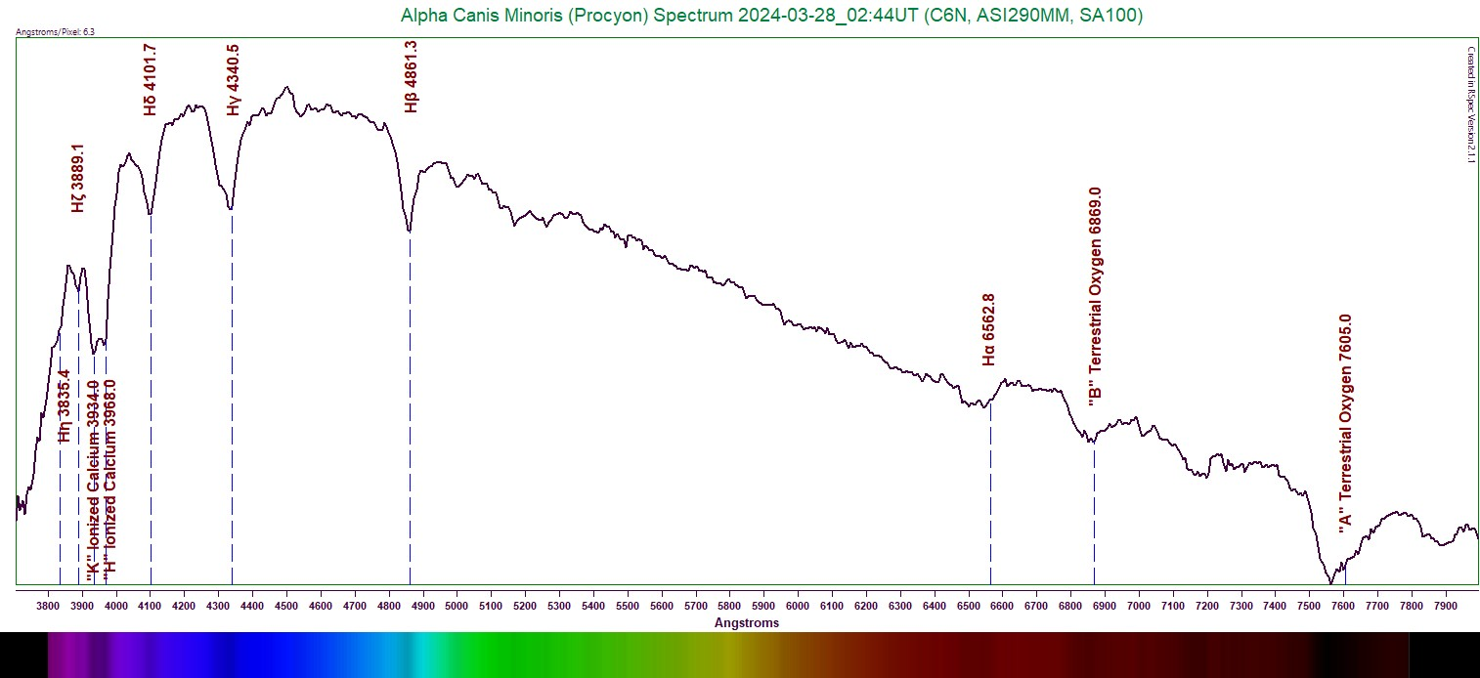
Alpha Canis Minoris Line Identification
Start with the most obvious lines
Verify lines in software or reference material used - Walker’s Atlas

Slide 19
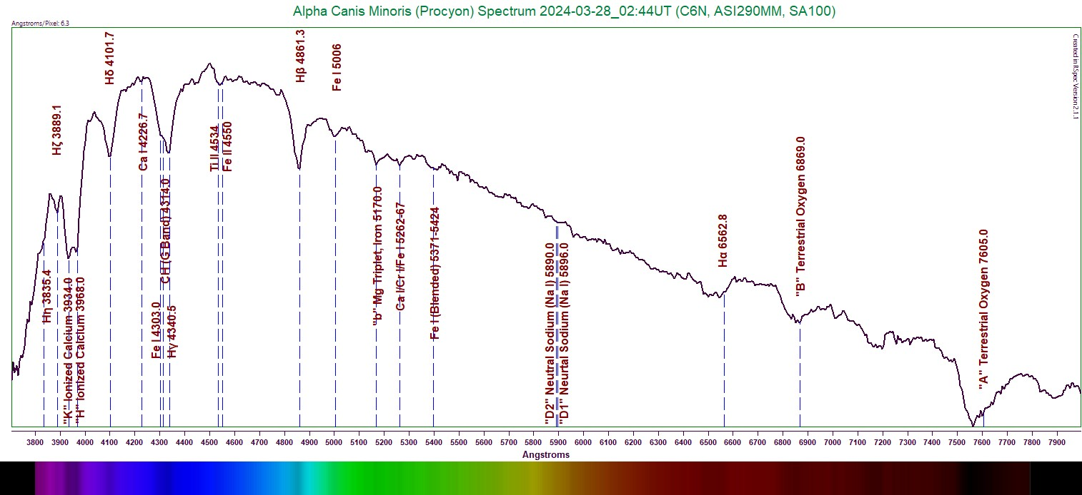
Alpha Canis Minoris Line Identification (continued)
Next, go back and investigate the moderate-sized dips in the continuum and look for possible matches in software or reference material

Slide 20
Alpha Canis Minoris Line Identification (continued)
Finally, carefully check for other line identifications
Beware of noise masquerading as a feature!
In low-resolution spectra, lines can appear blended together
Any questionable or uncertain identifications must be noted as such
Be sure to check features in stars up to one full stellar class removed from the star’s actual class - For this F5 star, check A5 through G5 - Many features stretch across stellar types - BUT, the farther removed from the actual class you go, the higher the probability of a false identification!
Expected lines may not be the only ones present!
The more practice you put in, the smoother this process will become

Slide 21
Alpha Canis Minoris Line Identification (Final Result)

Slide 22
Wien’s Displacement Law
Establishes a peak wavelength-temperature dependence - The hotter the star, the shorter its peak energy wavelength
Applies to perfect blackbodies - Absorb all the energy that falls onto them
Stars are NOT blackbodies - Still, this Law is used for some temperature estimates - The continuum line is an appropriate approximation of a blackbody
28978200/(Peak Energy Wavelength in Angstroms) gives resulting temperature in Kelvin
Is only approximately accurate for stars with peak energy wavelengths falling within the visible range
Is NOT accurate for earlier- or later-type stars (O-type, B-type, A-type, mid-to-late M-types)

Slide 23
Applying Wien’s Law
Create a continuum curve for the spectrum - Add points along the spectrum and draw a smooth curve matching the apparent continuum level of the spectrum.
Use as many points as you need. Your goal is to end up with a curve resembling the continuum level as closely as possible
Save the resulting reference curve
Reopen the curve in a new window, and use the mouse to determine at which wavelength the tallest part of the spectrum lies - This is the peak energy wavelength to use in the formula
Note: This continuum curve can also be used to create a Rectified Profile.
Divide the normal profile by the continuum curve (reference profile)
This results in a flat continuum line showing only the deviations—absorptions, emissions, and continuum noise - This process can be an aid to line identification, but it does remove some data, ie- the peak energy wavelength

Slide 24
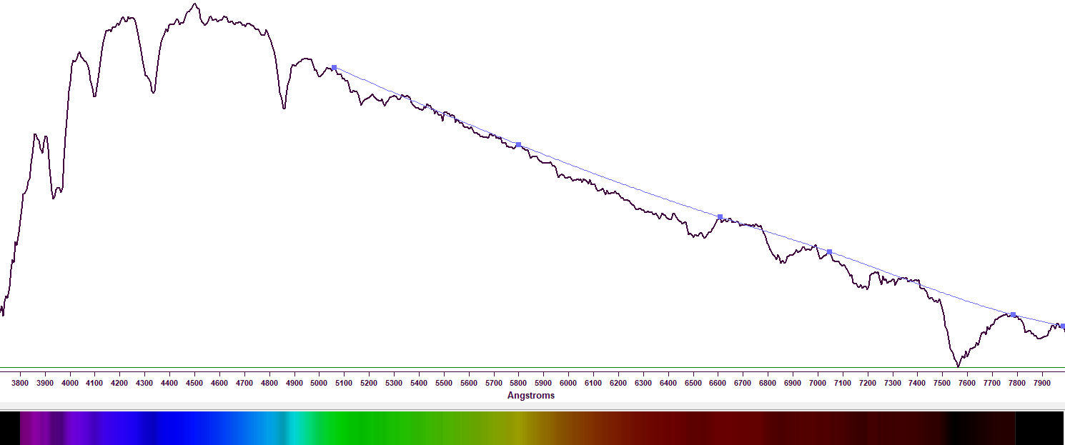
Alpha Canis Minoris Estimating the Temperature
Create the continuum curve
Use best-guess points to draw the line
Line should approximate the path of the underlying continuum
Be very judicious about this if you will use the curve to create a Recitifed Profile!

Slide 25
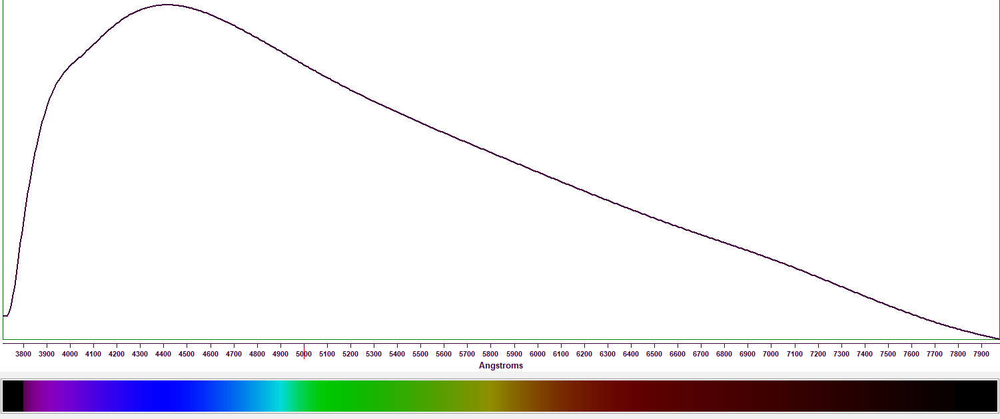
Alpha Canis Minoris Estimating the Temperature (continued)
Finish drawing the curve and Save the results

Slide 26
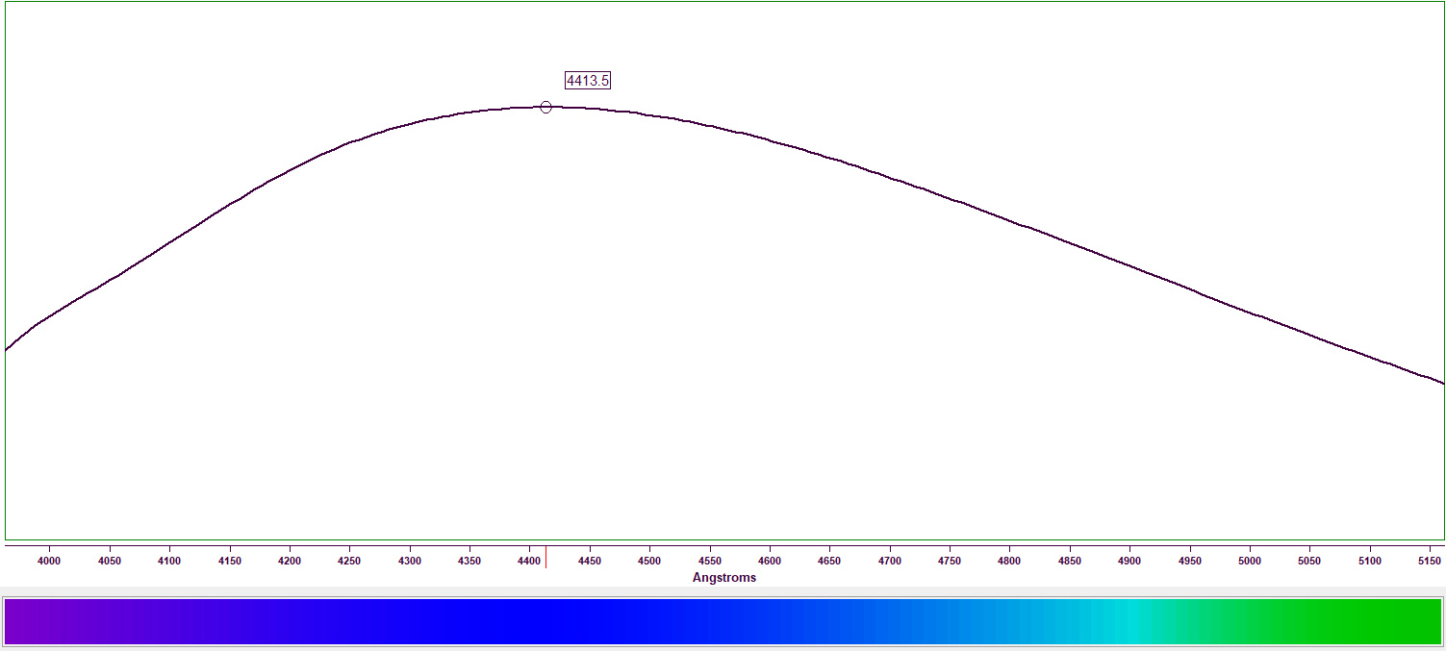
Alpha Canis Minoris Estimating the Temperature (continued)
Estimate peak wavelength of the curve
Estimate peak wavelength of the curve - 4413.5 Angstroms
Plug this value into equation for Wien’s Law - 28978200/(4413.5) = 6565K
Actual temperature is 6530K +/- 50K

Slide 27
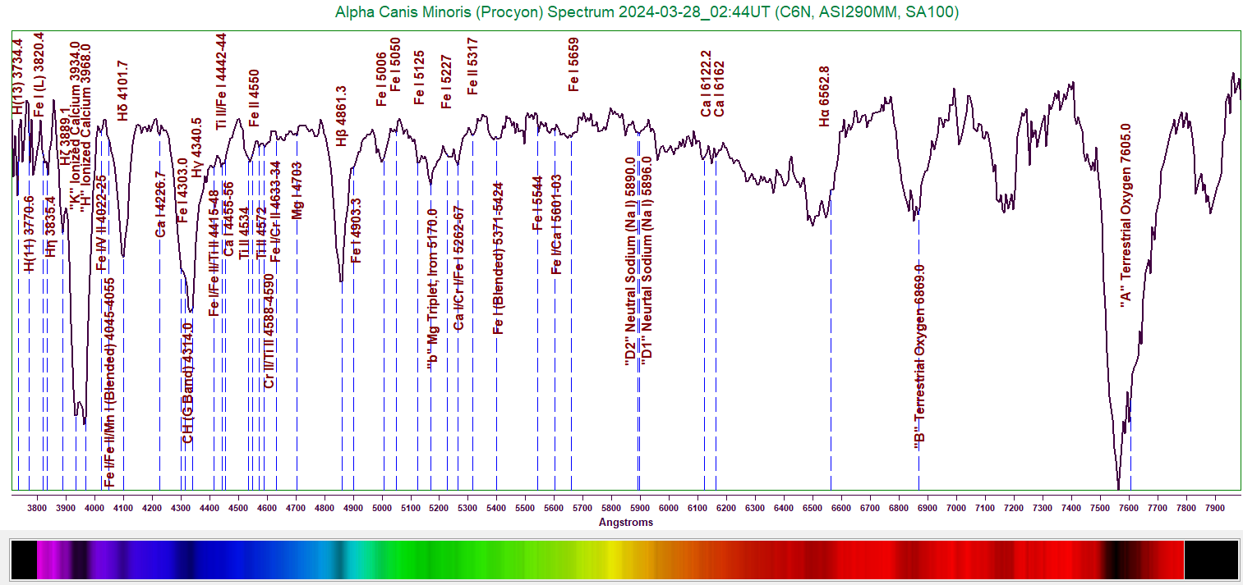
Alpha Canis Minoris Creating Rectified Spectrum
Open the star’s main profile
Open Reference Series and load the Continuum Curve that you created
Divide the Main Profile by the Reference (Continuum) Profile

Slide 28
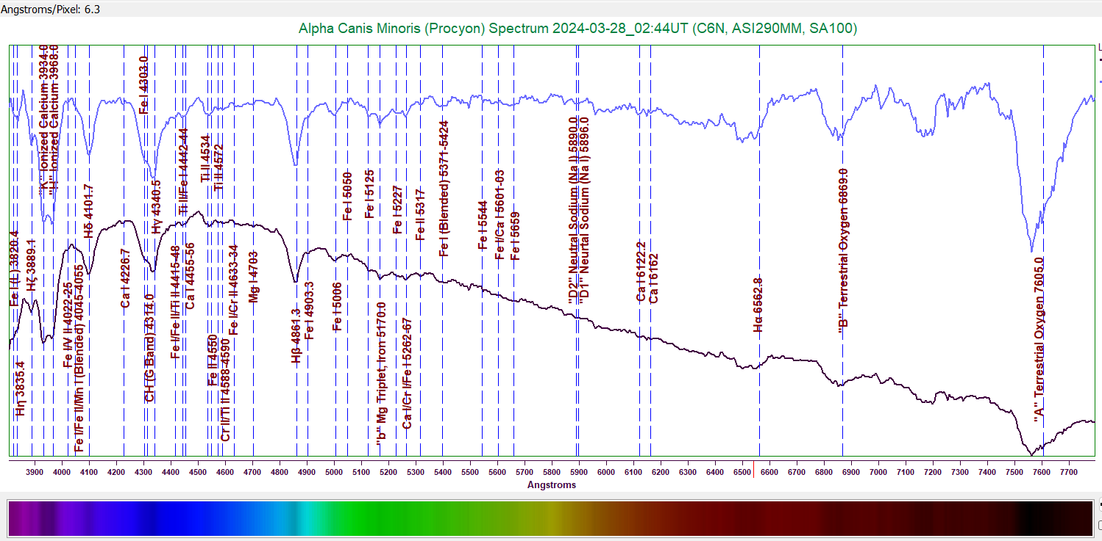
Alpha Canis Minoris Creating Rectified Spectrum (continued)
Caution! - RSpec sometimes doesn’t load the Reference Profile properly
Better to create the Rectified Profile immediately after drawing the Continuum Curve

Slide 29
Conclusion
Only relatively simple and inexpensive hardware and software is needed
A lot of information can be found with low-resolution spectra
Practice! Practice! Practice! - Don’t focus only on “special” stars
Contact me at: anthonyspectro@gmail.com
Harding Spectra Library available for free download at: https://www.rspec-astro.com/sample-projects/#SpectraLibrary

Slide 30
Q&A
Don’t be bashful—anyone with questions about any part of this is welcome to pose them now. I will do my best to answer them.

